Slide 1
Software Carpentry
Istvan Albert
Penn State

Slide 2
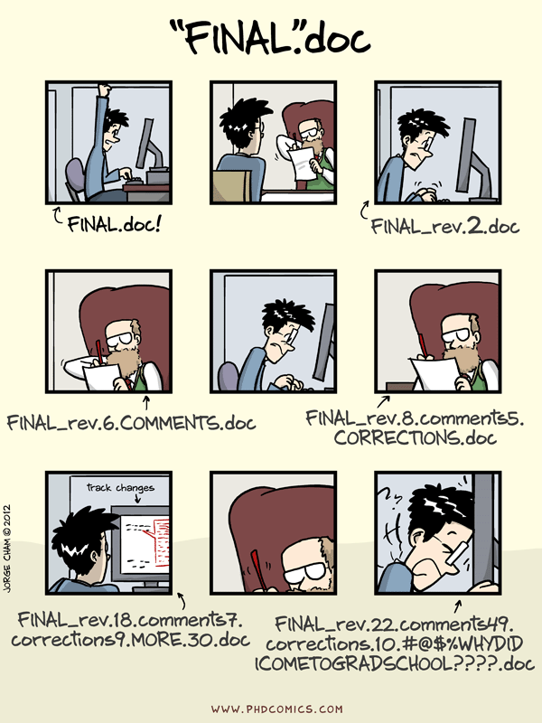

Slide 3
What makes research reproducible
It is knowing what has been done and how has it been done.
Enumerate the “set pieces”: data, code, parameters
Explain the rationale of behind making certain choices
Ensure consistency in space and time: from computer to computer, or this year to next

Slide 4
Reproducible research
It shouldn’t be an extra burden.
We do it because it helps us primarily.
We get better at those things that we practice
If we do it all the time, no extra effort is needed

Slide 5

JUST REDO IT

Slide 6
The three essential ingredients
Version Control
Documentation
Automation

Slide 7
Doing it live
“Live” slides to follow

Slide 8
Basic git commands
git clone - toe get a repository from hithub Ineeds to be done once)
Git status - the state of my git repository
Git diff - what exaclty has changed
Git add - add a new file to git tracking (needs to be done once)
Git commit -am ‘Some message” commits changes to added files
Git push - push to remote Git pull - pull from origin (automatic merge is possible)

Slide 9
Version controls everyting but BIG data
Document everyting - very short docs will to magic

